Slide 1
Electronic Vapor Devices, Vapor Inhalation Substances, & Hookah
City of El Cajon
July 22, 2014

Slide 2
Background
City Council Actions:
  January 14, 2014
    Requested information on electronic vapor devices, substance inhalation products, & hookahs
  March 11, 2014
    Information provided
    Discussed possible alternatives
    Adopted Resolution No. 020-14

Slide 3
Background
Equate with tobacco products & use
Define electronic vapor devices, inhalations substances and hookah – ensure code consistency
Require minor conditional use permit to sell
Prohibit or allow lounges subject to specific regulations
Assess tobacco license inspection program & fee

Slide 4
Background
City Council Actions:
  May 13, 2014
    Ordinance No. 5008
    Moratorium on new businesses
  June 24, 2014
    Extended moratorium
    Ordinance No. 5009

Slide 5
Background
Planning Commission
  Discussion/Workshop – July 1, 2014
  Public Hearing – July 15, 2014
    Recommended City Council Approval
      Exclude provisions allowing accessory outdoor vapor areas
      Add vocational/professional schools, colleges, universities, etc. to list of sensitive uses under spatial requirements

Slide 6
Proposed Code Amendments
Title 5 - Tobacco Paraphernalia
  New definitions
    Electronic vapor devices, vapor inhalation substances, hookah pipes
Title 8 – Public Smoking & Tobacco Retailers
  New definitions
  Refined existing definitions
  City Manager to determine inspection frequency
    Best uses of resources
    When warranted

Slide 7
Proposed Code Amendments
Title 17 – Tobacco & Smoke Shops
  New & refined definitions
    Comprehensive
    Equates with tobacco
    Includes stores & lounges
  Vapor Device Stores & Lounges
    Conditional Use Permit required
    Equates with tobacco and smoke shops

Slide 8
Proposed Code Amendments
  Sensitive use spatial standards
    500 feet – residential
    600 feet - religious, schools, parks
    1,000 feet – tobacco shops, vapor shops & lounges
  Operational standards – Vapor lounge
    Age restriction
    Hours of operation
    Conduct of use

Slide 9
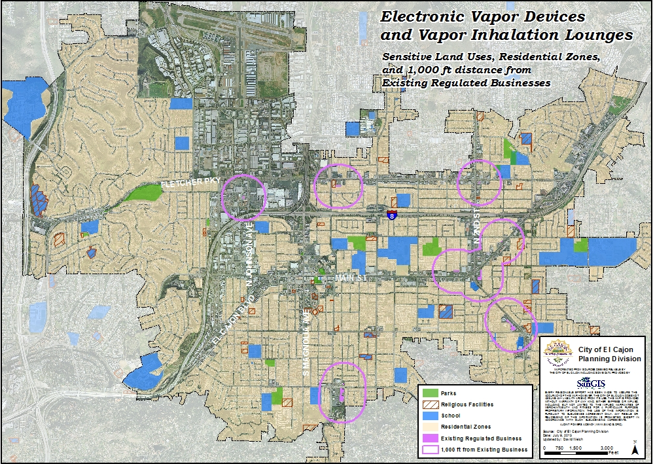
Existing Tobacco & Smoke Shops

Slide 10
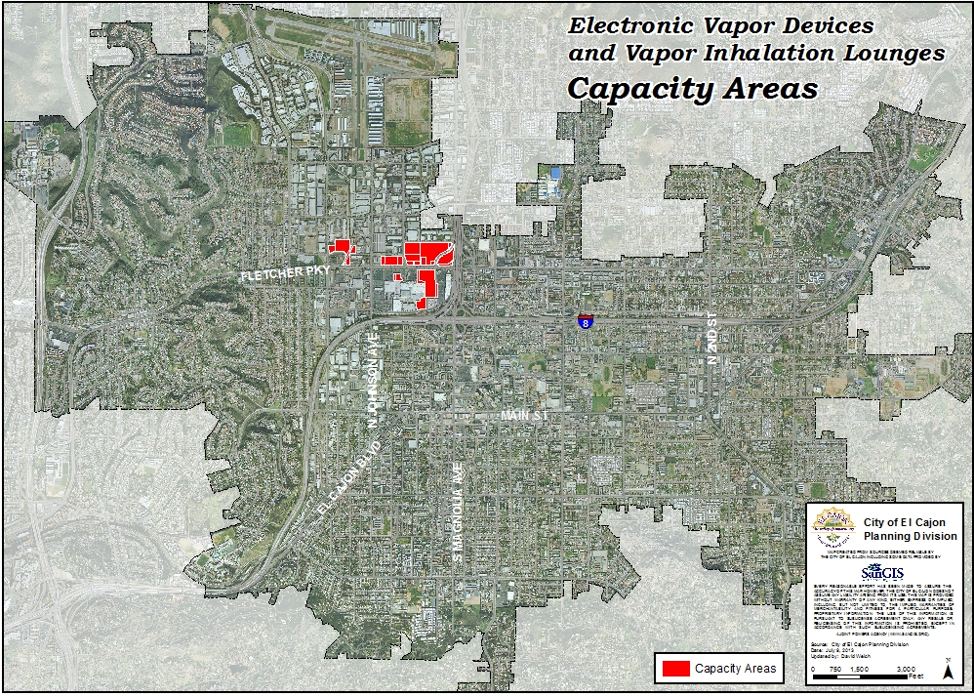
Capacity Areas

Slide 11
Proposed Code Amendments
  Outdoor vapor use area
    Accessory to uses with outdoor use areas (e.g. restaurants, cafes, coffee shops)
    Minor conditional use permit
    Defined area
    Operational standards
    Potential drawbacks
      “Secondhand vapors”
      Difficult to distinguish from traditional tobacco products

Slide 12
Proposed Code Amendments
  Commercial Land Use Table – 17.145.150
    Adds “electronic/vapor substance inhalation shop and lounge”
    Conditional Use Permit
  Section 17.210.100 – Alcohol Sales Ordinance
    Updates signage standards to include electronic vapor products with reference to Section 8.33.010

Slide 13
Similar Approach
San Diego County
La Mesa
Carlsbad
Del Mar
Encinitas
Oceanside
Solana Beach
Vista

Slide 14
Tobacco License Inspection & Fee
Code amendment reduces need for annual inspection
Current fee is $675
Estimated cost is $541
  City cost to issue = $230
  Compliance monitoring = $311

Slide 15
Tobacco License Inspection & Fee
Options
  Maintain status quo
    Annual inspection requirement
    Surplus revenue for enhanced education
  Retain annual inspection & reduce fee to $541
  Approve Code Amendment
    Reduce inspections
    Further analysis required to determine reduced fee

Slide 16
Community Input
Community Notices
  Tobacco retailers
  Ice Lounge
  CASA
  Speakers at previous Council meetings
Community Representative Meeting with CASA
Planning Commission Meetings

Slide 17
Findings
General Plan Consistency
  Designed to ensure compatibility
Public Necessity/General Welfare
  Does not significantly alter City character
  Implements community health and safety policies

Slide 18
California Environmental Quality Act
General Rule
  CEQA Guidelines Section 15061
  Proposed amendments do not increase potential development to level of significance

Slide 19
Recommendation
Adopt proposed ordinances amending Titles 5, 8 and 17

Slide 20

City Council Discussion

