Slide 1

East County Advanced Water Purification Update
Santee City Council
March 24, 2021

Slide 2
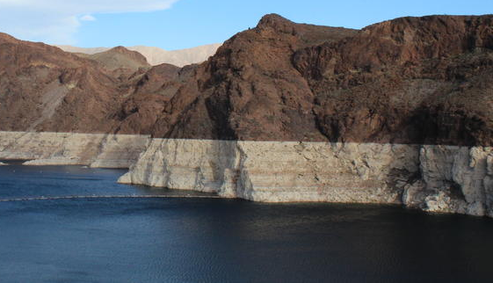
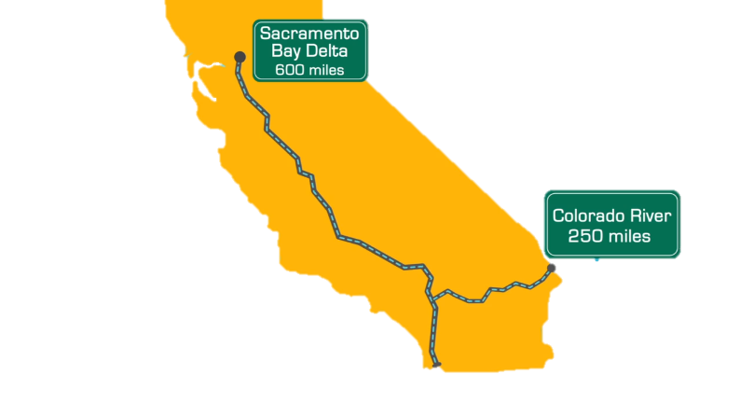

Water Concerns
11%
State Water Project
Colorado River Basin
72%
Colorado River
Oversubscribed by 1.5maf annually;
Reduced snowpack = reduced total river supply by 10%
SAN DIEGO’S WATER SUPPLY
SOURCES: Metropolitan Water District of Southern California 2019
San Diego County Water Authority
Notes:
We’re at the end of a very long pipeline – literally.
About 11 percent of our water supplies travels more than 600 miles through the California Aqueduct.
Half of the region’s water supplies travels nearly 300 miles from the Colorado River, a stressed, over-allocated river that has seen diminished supply over the past decade.

Slide 3
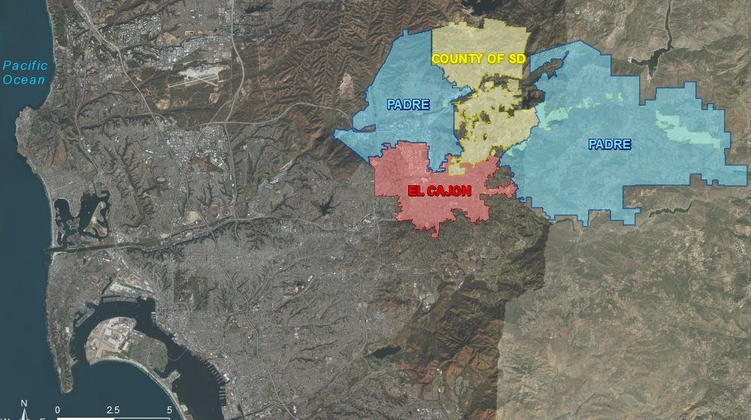



Notes:
All of East County’s wastewater travels 20 miles to Pt. Loma Treatment Plant operated by the City of San Diego.

Slide 4
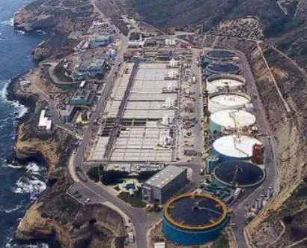
Wastewater Issues
Pt. Loma Treatment Plant – City of San Diego
11%
State Water Project
1963
240 MGD capacity
2.2 M population
Modified Permits: 1995, 2002 and 2010
In 2015, permit renewal of the operating permit for the Pt. Loma Plant, new requirements were placed on the City to either:
offload wastewater flows, or
upgrade the plant’s treatment processes to secondary at an estimated cost of approximately $1.8 billion.
72%
Colorado River
Notes:
Highlight modified permits
2015 EPA and NGO’s demand an offset or upgrade
Cost will be $1.8B

Slide 5
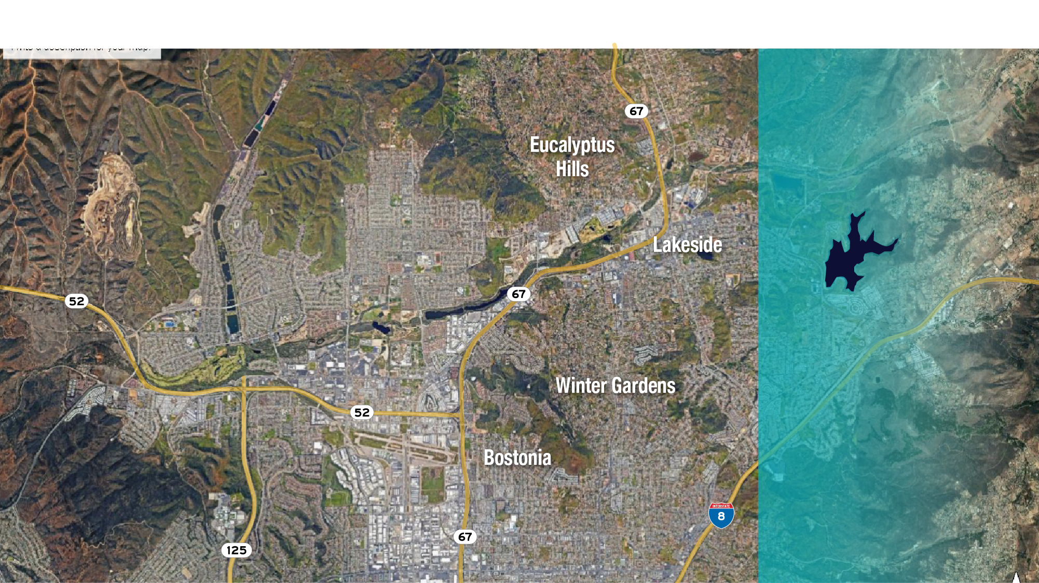

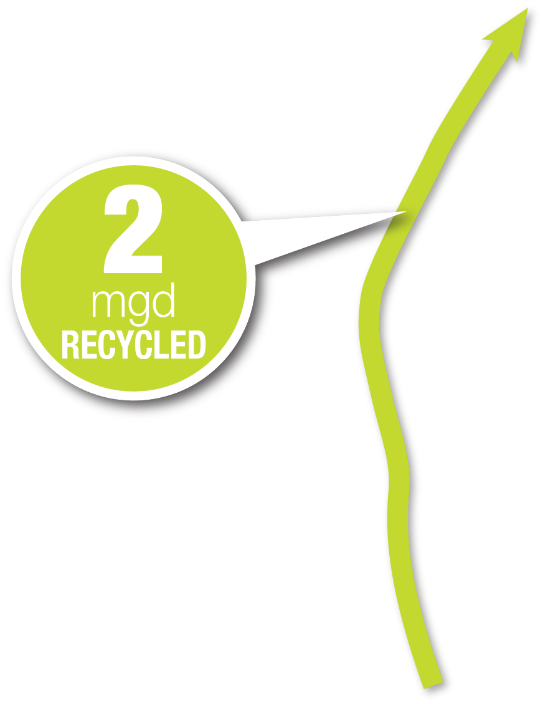
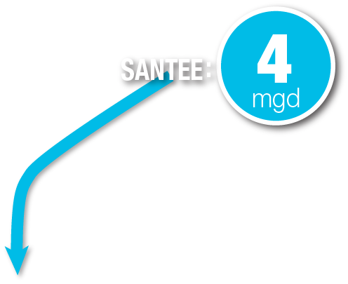
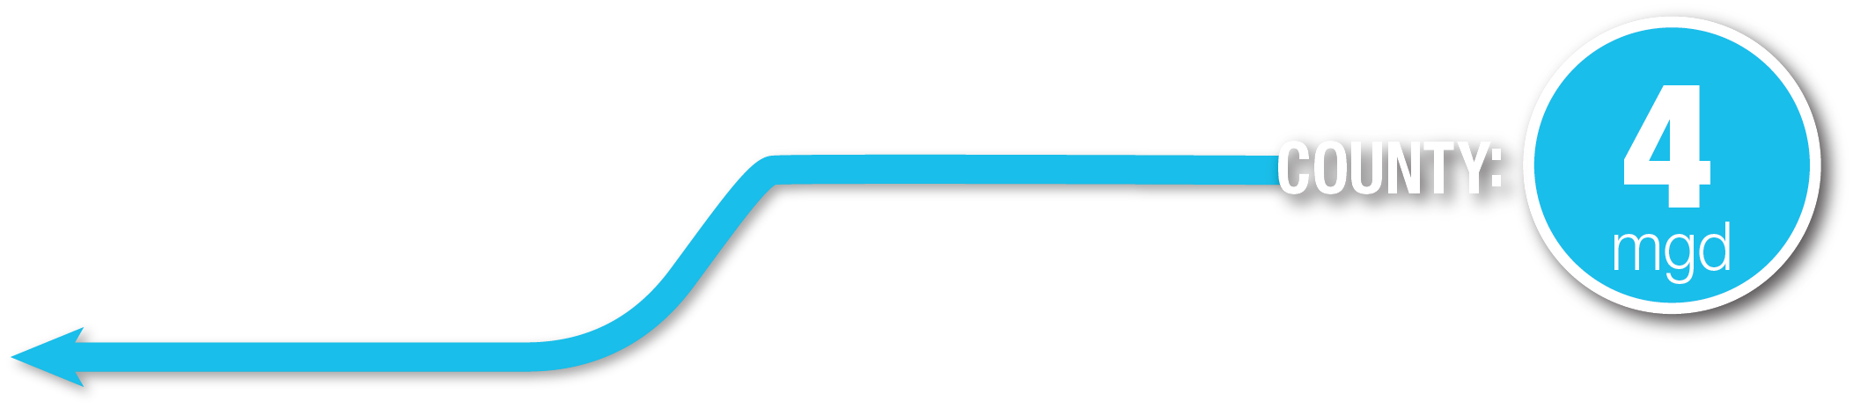

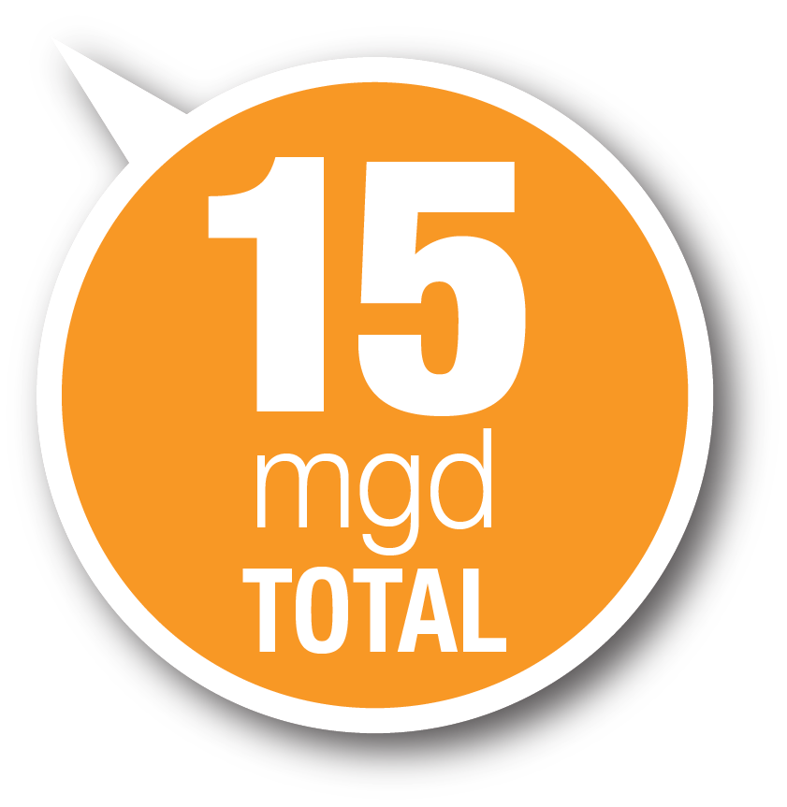
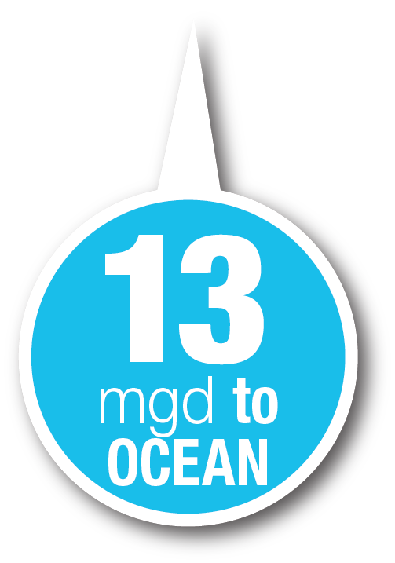
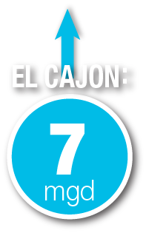
Project Overview
Notes:
Highlight our opportunity for 15 MGD
Only recycling 2mgd

Slide 6




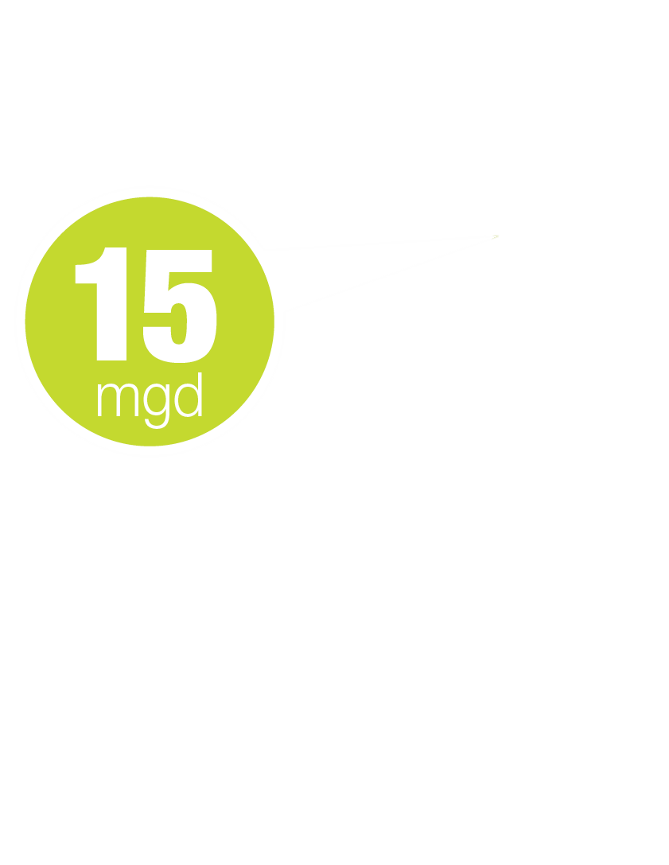
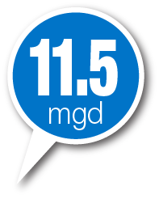
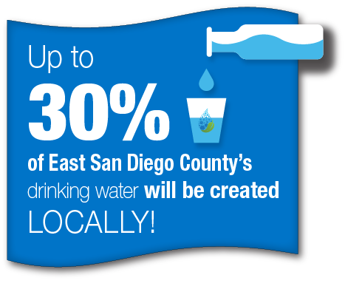

Project Overview
X
Notes:
End transport 20miles
Capture all 15 mgd
Construct new plant and treat 15 mgd
Transport to Jennings
Creating 30% of East County’s Water locally

Slide 7

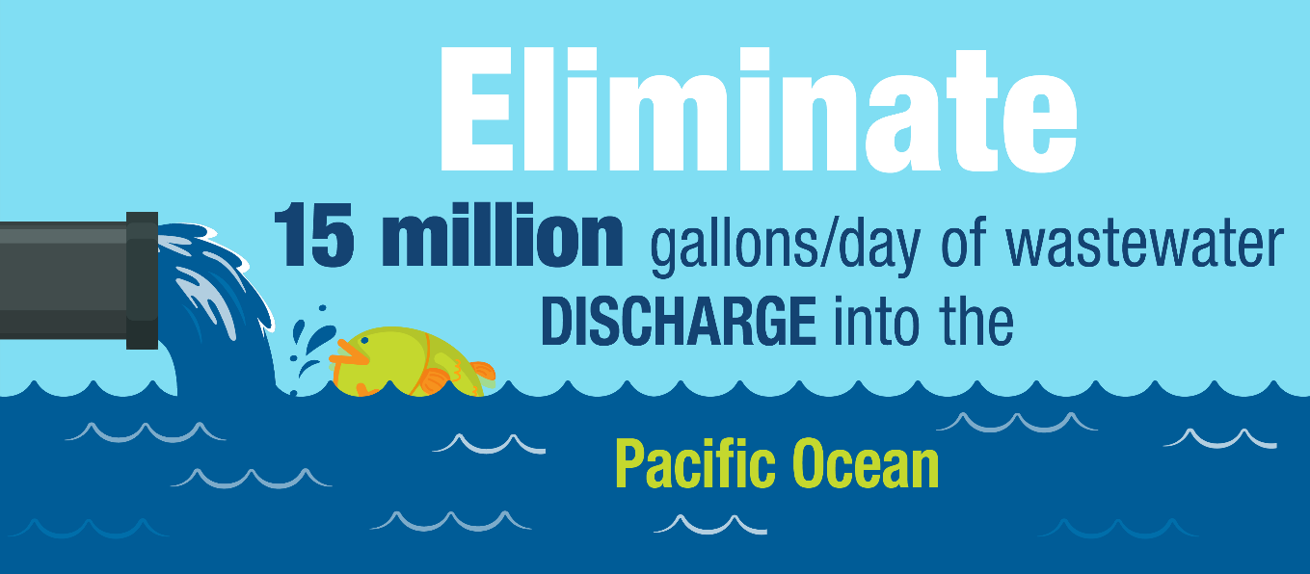
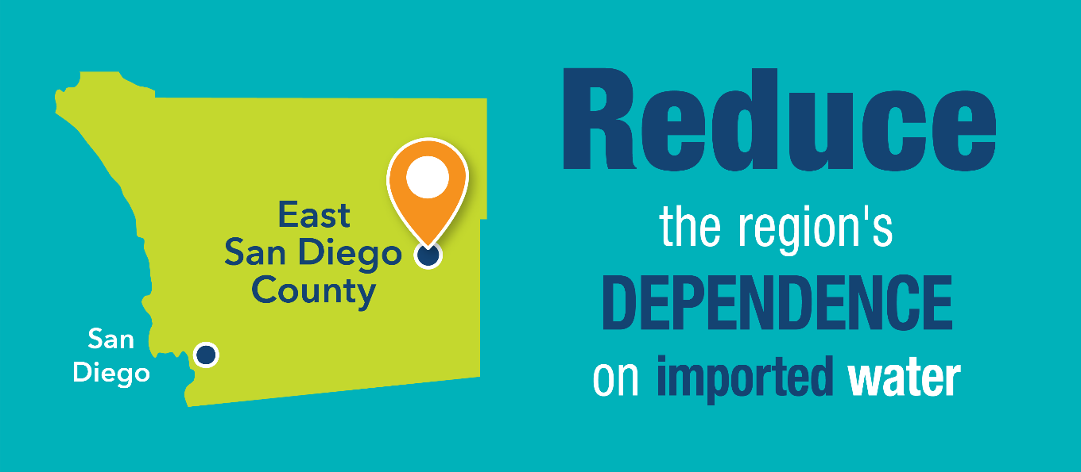
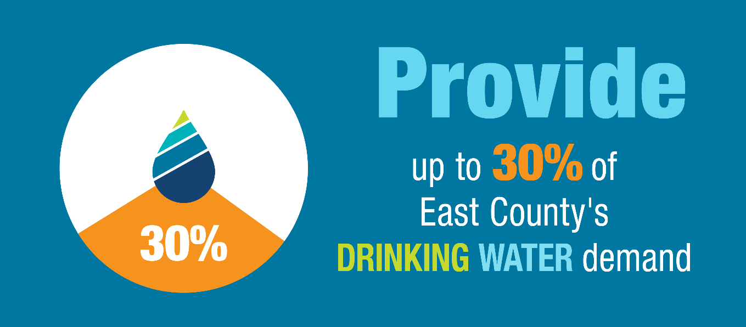
Goals and Objectives
Notes:
Self-explanatory

Slide 8
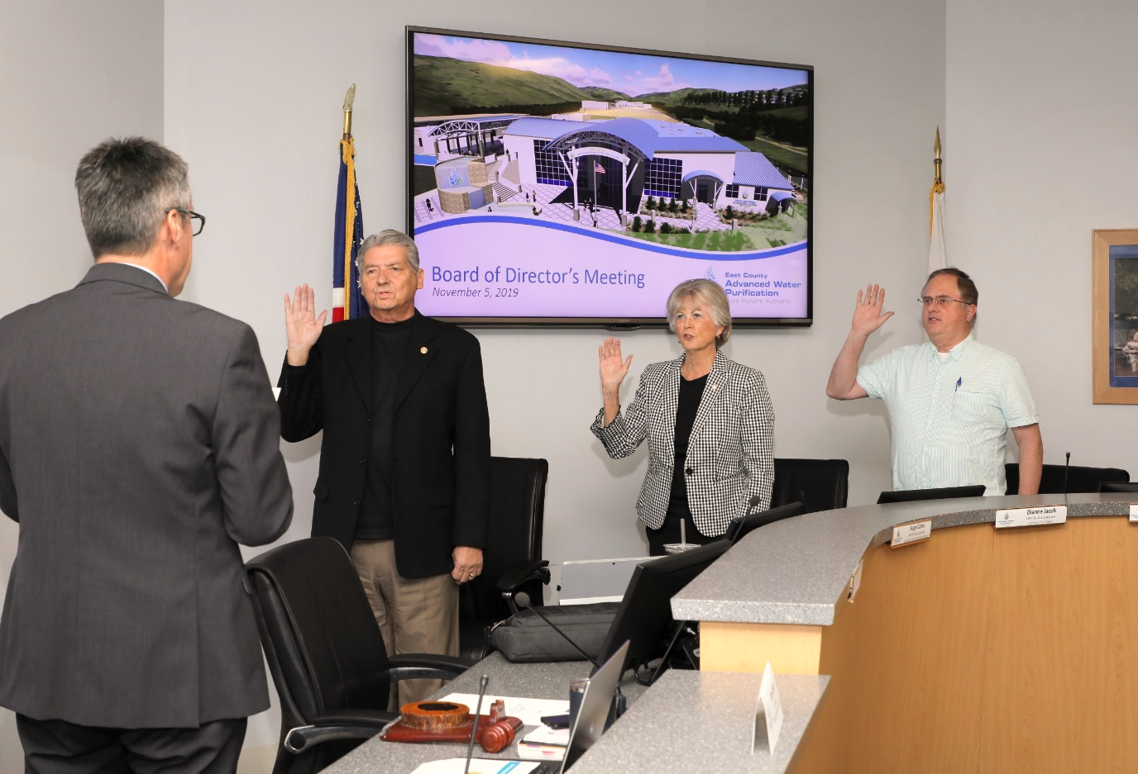



JPA Agreement Formation
Members:
First meeting: Nov. 5, 2019
Notes:
Project bigger than one agency
EC, County and Padre joined together
November 2019 created

Slide 9
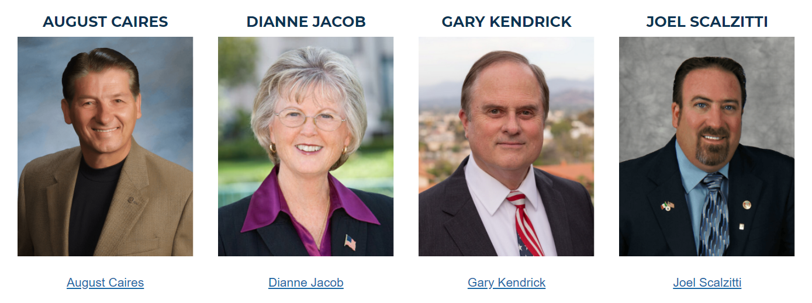
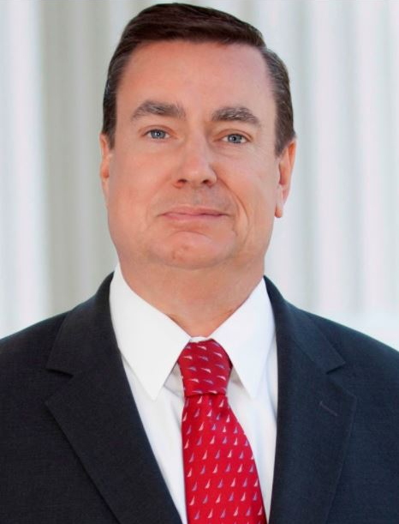
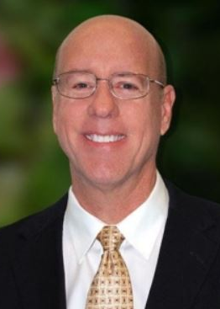

Current JPA Board of Directors
EX OFFICIO
Augie Caires
Joel Anderson
Steve Goble
Joel Scalzitti
Notes:
New Board
Review names

Slide 10
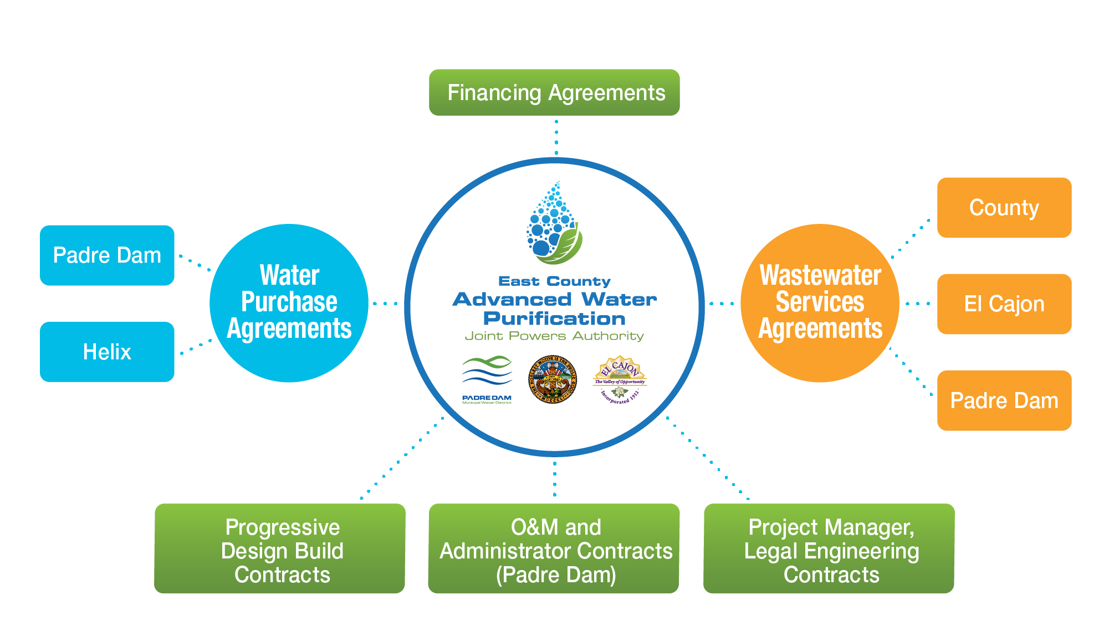

Governance Structure
Notes:
Wastewater agreements
Water agreements
Padre to be Operator & JPA Administrator
All contracts flow thru JPA

Slide 11
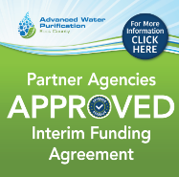

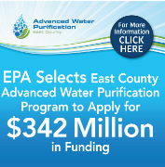

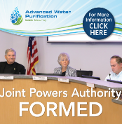
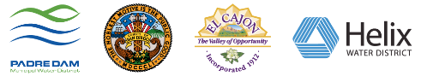


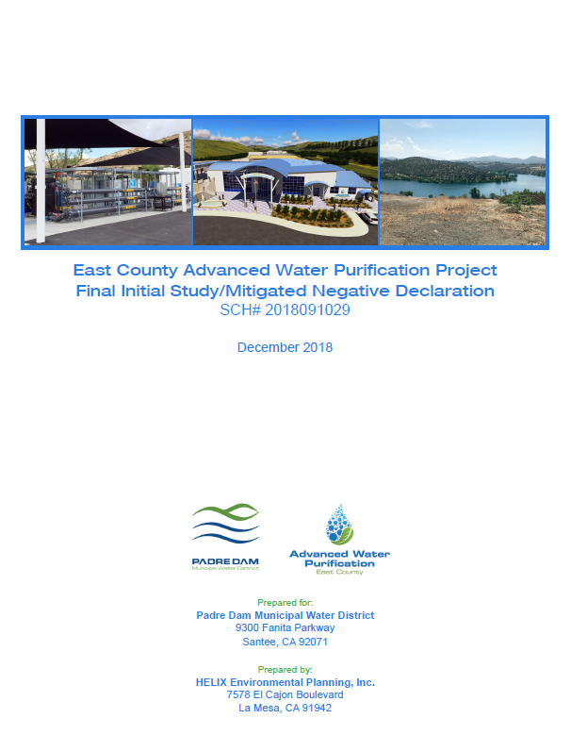
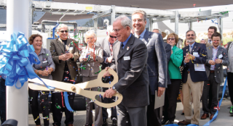
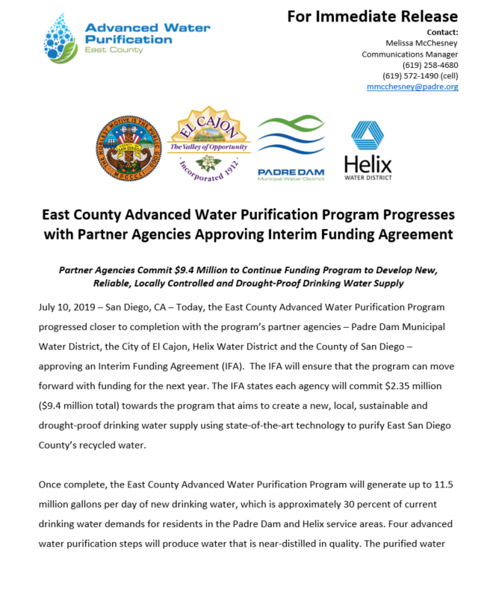
A few milestones
East County AWP Project Overview
2017
2019
Water Agency
of the Year
MOU Extension
$116M Grant & SRF
DDW Conceptual Approval for the project
Interim Funding Agreement: $9M
2014
AWP Demonstration Plant Groundbreaking
Feasibility Study MOU
EPA selects ECAWP to apply for WIFIA: $342M
JPA Formed
AWP Demo Plant Opening
Secured $90M from MWD
Agreements Executed
2015
CEQA Complete and Approved
Design-Build Contracts Executed
2018
2020
Notes:
Emphasized the time and effort spent
Project started as a Padre-only Ground Water Injection potable reuse program in 2012
Recognized the value of a partnership with other East County Agencies to benefit more than just Padre’s service area
2014 began the feasibility study on the larger Reservoir Augmentation project with partners.
Walk thru the remaining milestones emphasizing this slide shows only a very few.

Slide 12



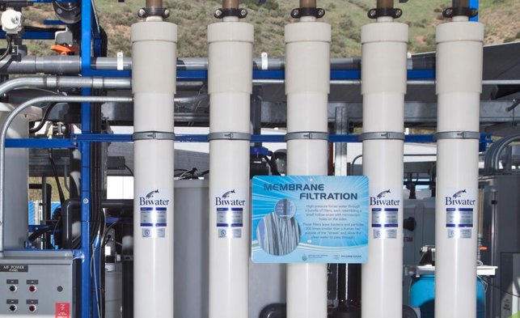
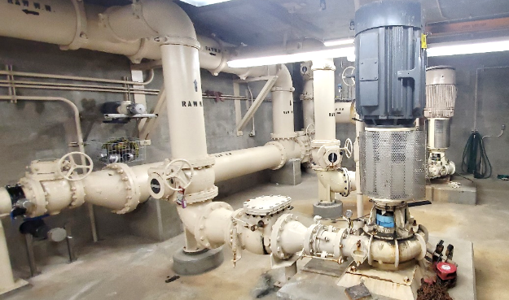
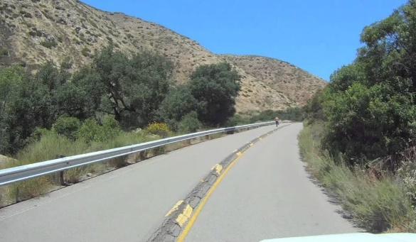
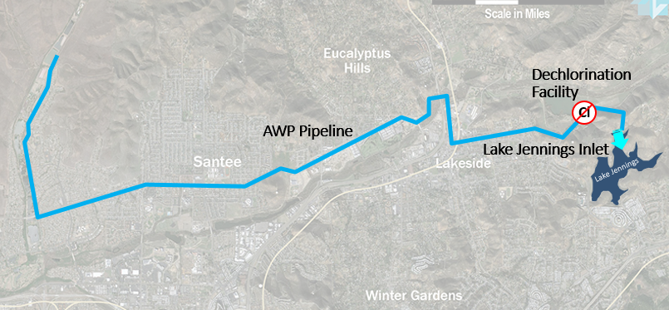
Progressive Design-Build Team Selection Process
PACKAGE #1: $300M
PACKAGE #2: $45M
PACKAGE #3: $45M
PACKAGE # 4: $50M
Coming Soon
16 MGD Water Reclamation Plant
11.5 MGD Advanced Treatment
Solids Handling
11+ mile AWT Water Pipeline
De-Chlorination Facility
Lake Jennings Inlet
EMGPS Upgrades
IPS Upgrades
New Force Main & Residuals Bypass System
EMGFM Rehabilitation
Regional Brine Line
RFQ issued on March 5
$ 600M~

Slide 13
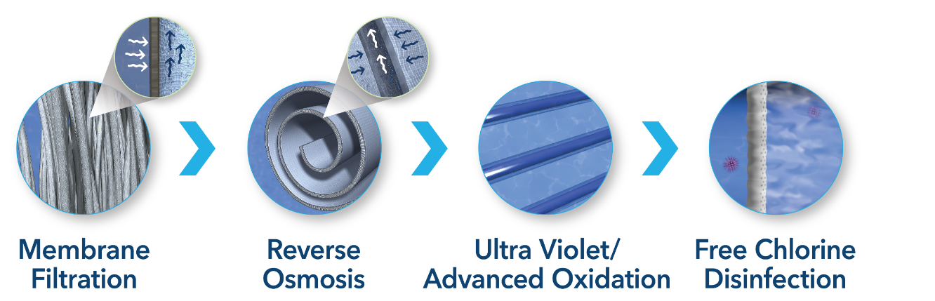
Collaboration with the City of Santee
MOU: Development of the Project
JPA will share plans and documents with the City;
City to provide review and comments on plans;
City and JPA will meet together on a periodic basis;
JPA will communicate, keeping the City informed on progress.
Notes:
This project is a very unique “regional public project.” Government Code section 6509, cities, counties and JPA’s (exercising powers common to the Member Agencies) are exempt from the building and zoning ordinances of other cities or counties when operating therein.

Slide 14





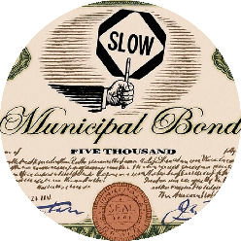

Project Funding
Prop 84: $6M
WIFIA:
$390M IN PROGRESS
Prop 1: 15M
Grants + Incentives$131 Million
Low Interest Loans $101 Million
Title 16: $20M
SRF: $101M
$135M IN PROGRESS
MWD: $90M
BONDS:
IN PROGRESS IF NEEDED
WINN: IN PROGRESS
Notes:
Emphasize the success we’ve had to date $131M in Grants/Insentives; $101 in low interest loans
Explain we’ve been selected, which typically means selected, for approx. $342M in WIFIA and an additional $135M in SRF
Interest rates with WIFIA and SRF are extremely low: .9 to 1.3%
The financial model assumed much higher debt service levels.
If/When ☺ we are successful in securing WIFIA & SRF the project will see a savings of $160M over it’s 30 year life.

